Slide 1
Restaurant Chain Visit Study
BAN 840
Jan 19, 2024
Shiv Walecha

Slide 2
R & G Visits Analysis
R&G restaurant chain needs to create a promotion that will encourage customers to visit their restaurant
Data includes a survey of average monthly restaurant visits (including not to Ranch and Garden) for 60 customers
Household incomes studied are between the range of $29,000 and $316,000
Study objective:
Determine the strength of the relationship between
Income of the customer
Number of visits
Develop a regression model to predict the average monthly visits based on income
Characterize the regression model

Slide 3
Approach
Describe and summarize data (what data do I have)
Prepare statistical summary of data and scatter plots to assess correlations and determine if the linear regression is appropriate
Determine if transformation of variables is appropriate or not
For our case variable y is average monthly restaurant visits per individual and variable x is household income
Once we determine which transformation is required, we will make the changes to the r code accordingly.
Fit and present the regression model and assess the predictive ability of the model
Perform performance measures, validity checks, and statistical characterization
Characterize statistically the model with annual incomes of $50,000, $100,000, $200,000 using 95% confidence and prediction intervals
Give recommendations to the restaurant on which income bracket to target

Slide 4
Income and Visits summary
R Code to import the data and store it in a variable Rest Visit Data Full file
library(readxl)
RestVisitDataFull <- read_excel("D:/MBAN/Predictive Analytics/Group Assignment/RestVisitDataFull.xlsx")
summary(RestVisitDataFull)
60 records
Maximum income, 316,900, minimum 28,800.
Maximum visits, 12, minimum 1.2.
Income Visits
Min. : 28.80 Min. : 1.200
1st Qu.: 53.33 1st Qu.: 4.250
Median : 70.05 Median : 5.200
Mean : 90.11 Mean : 5.697
3rd Qu.: 91.38 3rd Qu.: 6.575
Max. :316.90 Max. :12.000

Slide 5
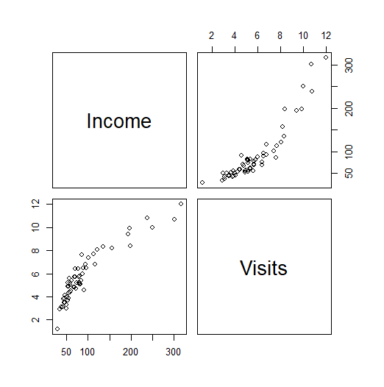
Correlation plots
We first check the scatter plot using the following R code: pairs(RestVisitDataFull)
This R code describes the correlation between the two variables.
It is clear from the graph that the scatter points are concentrated towards the left, there are some distant points towards the right, (x axis – Income and y axis – Visits). Thus, we can say that the data is skewed towards one side and there is a non-linear pattern.

Slide 6
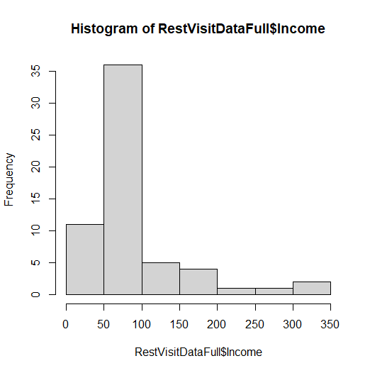
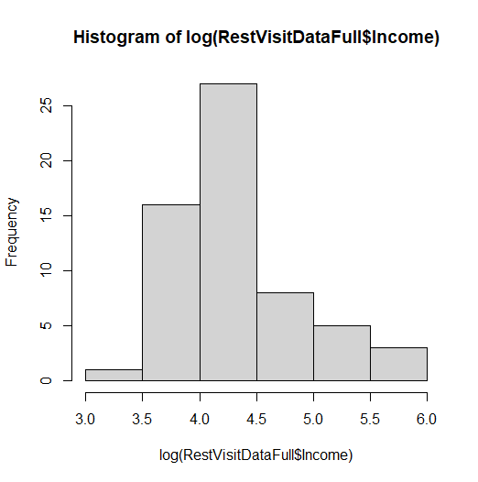
Before and After transformation of x
The histogram initially exhibited skewness in the distribution of variable X.
However, upon applying a logarithmic transformation to X (log X), the distribution shows signs of becoming more symmetrical or normal.
R-code: Histogramhist(RestVisitDataFull$Income)hist(log(RestVisitDataFull$Income))

Slide 7
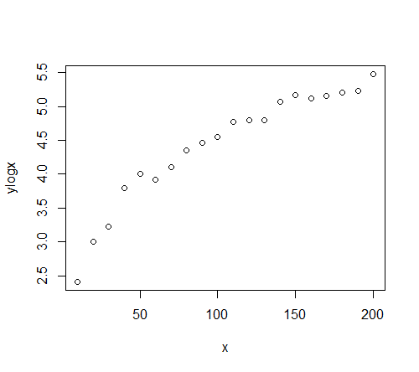
Transformation of X
Justification for using log x:
The scatter plot showed non-linear relationship and hence transformation is necessary. Based on the pattern and the skewness of the data, transformation of variable x using logs would be appropriate to make the model more linear.
Because there is a curvilinear relationship but the variability (vertical spread) of the residuals seem pretty constant, we should transform x.
The r-code to transform x to log x would be:
RegressionModelx = lm (Visits ~ log(Income) , data = RestVisitDataFull)
summary(RegressionModelx)$coefficients[,1]
plot(predict(RegressionModelx, newdata = RestVisitDataFull), RestVisitDataFull$Visits)abline(0,1)
summary(RegressionModelx)$r.squared
Use log x, in case the data exhibits the above pattern

Slide 8
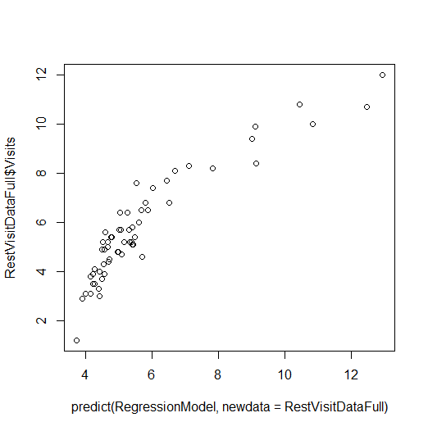
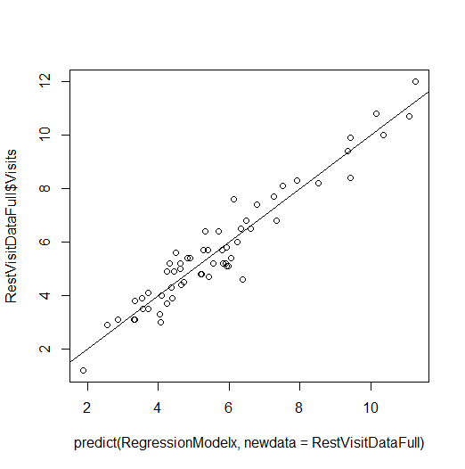
Transformation of X
On transforming the x as log x, we get the adjacent visualization.
As we can see the visualization is a lot linear now. Further the R2 is 92.10% which indicates that a significant proportion of variability can be explained with the transformed predictor variable log x. A higher R2 suggests a stronger fit for of the predictive model of the data.
On transforming the data using log x, we now have a near to linear relationship as we can see the graph.
Also, there is a reduced skewness in the data.
Further the spread of the data from the predictor line is also less and the model is now a closer fit. This further increases the predictive power of the model.
We have not used any indicator variables to predict the model.
For checking the i.i.d assumptions, validity test have been performed on the slides to come.
Mathematical presentation of the model
𝑌 = 𝛽0 + 𝛽 1𝐿𝑜𝑔(𝑥) + 𝜀, 𝜀~𝑖. 𝑖. 𝑑. 𝑁(0, 𝜎2)
Before transforming
After transforming

Slide 9
Interpretation (Regression Model Fitted Coefficients)
Summary intercepts:
(Intercept) log(Income)
-11.297213 3.919846
When we are using log, the interpretation is in % terms.
Now log of 0 is undefined so in no case can it be considered as NIL
Simply put, for every 1% increase in the income the visits increase by 0.0392

Slide 10
Regression Model Predictive Ability
The plot shows the visits predicted by the model on the x-axis, and actual visits on the y axis. We see that the fit is good. This is also supported by the relatively high R² value of 0.92, which indicates that a significant proportion of variability can be explained with the transformed predictor variable log x(A higher R2 suggests a stronger fit for of the predictive model of the data).
The code below shows the R commands to generate the plot and show the model R²:
plot(predict(RegressionModelx, newdata = RestVisitDataFull), RestVisitDataFull$Visits)
abline(0,1)
summary(RegressionModelx)$r.squared

Slide 11
Regression Model Validity Checks
We need to check model validity before we proceed forward. For this we need to check independence of error, errors always distributed with mean zero and constant variance, and errors normally distributed. Also, we need to check the influential outliers so that they do not affect the regression coefficients estimates.
First, we use the plot(RegressionModelx) for the four residual plots
Also, can compare the residuals for each independent variable. In this case we just have one independent variable.
Also, we need to check independence of error about the mean

Slide 12
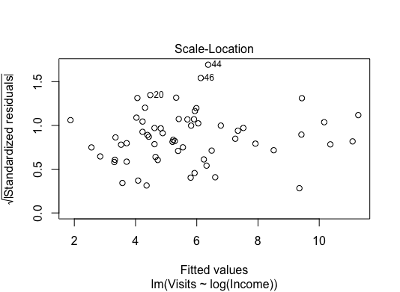
Equal Variance
We need to check that the residuals have equal variances
There is no clear pattern suggesting roughly equal variances
The vertical point spread towards the extreme values is less, with one or two outliers.
With equal variance, less spread is natural if fewer data in that region, so equal variance also supported by this plot

Slide 13
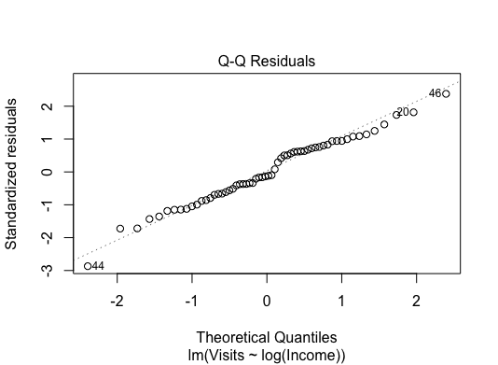
Normal Distribution for Errors
There is just a slight deviation from the line, but most of the points fall on the line.
Thus, normal distribution is supported.

Slide 14
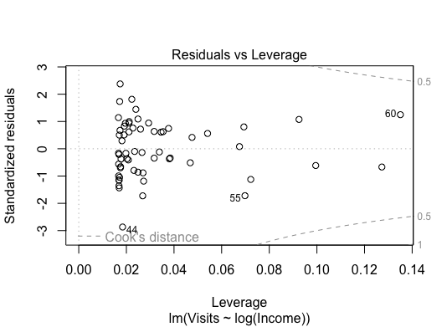
No Unduly Influential Outliers
The points beyond the Cook’s dash line are influential outliers.
In this we can see the dash lines, and it is evident that none of the points are outside or beyond the dashed line.
There are no outliers that need further examination.

Slide 15
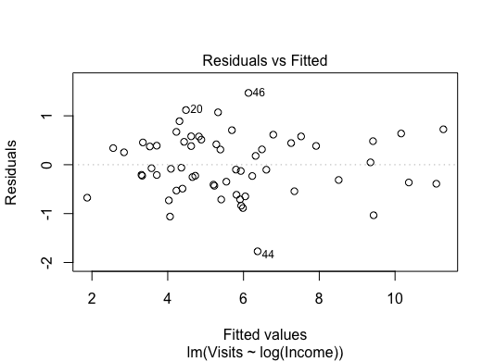
Residual vs Predicted
There is no visible pattern in this visualization.
This means that 0 errors is supported across all the predicted values
Also, the equal variance assumption is supported

Slide 16
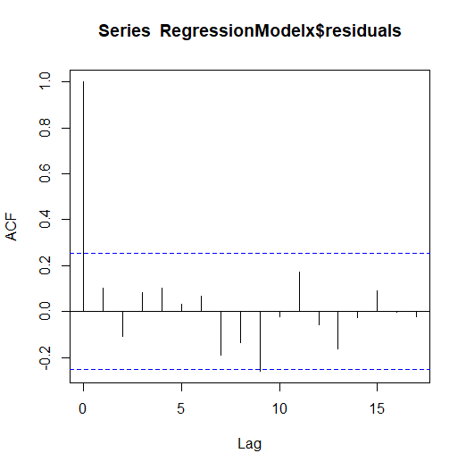
Validity Check: Independence of Error (Auto correlation check)
Autocorrelation checks if the errors in our predictions are related to nearby errors in the dataset. We look at up to 20 positions behind each error.
The dashed lines show bounds for autocorrelations indistinguishable from zero with 95% confidence.
The dash lines give us a range, if the auto correlation fall within this range, it is likely due to random chance.
One important thing to note is that the correlation of each data point with itself is always 1, so we don't include it in this check.
In our case, only one of the other 20 autocorrelations falls outside the expected range. So, 5% (1 out of 20) could expected to fall outside the bounds when the population correlation is 0.
Also, there is one point that almost crosses the dotted line, which is not that significant.
Therefore, the independence assumption is supported by the data.

Slide 17
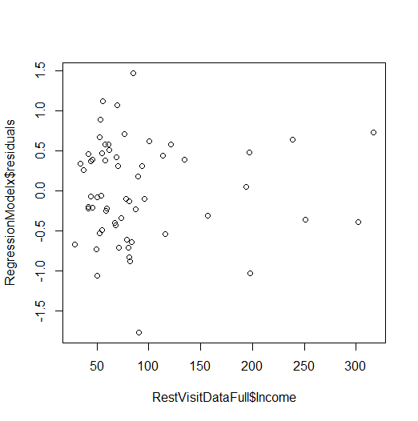
Validity Check: Residuals vs. Income
No apparent pattern. Mean zero errors is supported across all predicted values.
Equal variance errors also supported.

Slide 18
Validity Check: Summary
Based on the above validity checks, we can say assumption of independent and identically distributed is valid (including the autocorrelation check to check the independence of error).
Thus, the model with transformed x (Income, log x) can be used to predict the value of the y (visits)

Slide 19
Statistical Characterization
We have confirmed the validity of the regression model, relying on the statistical properties of model terms and the associated uncertainty. This validation process involves scrutiny through specific R commands:
anova(RegressionModelx)
summary(RegressionModelx)
confint(RegressionModelx)

Slide 20
Model ANOVA and Interpretation : Comment on the f value
Anova test:
The pr>f is also extremely low which indicates a high level of significance and the effects of this factor on visits is not just due to random chance. The low p-value provides strong evidence against the null hypothesis that the coefficient for log-transformed "Income" is zero (no effect).
A lower mean square of the residuals indicates that is well fitted model.
The mean square for Residuals is the estimate for σ ², the error variance so the estimate for σ = sqrt(0.389) = 0.6236 (thousand). This is basically the standard deviation of the errors in our regression model.
Analysis of Variance Table
> anova(RegressionModelx)
Analysis of Variance Table
Response: Visits
Df Sum Sq Mean Sq F value Pr(>F)
log(Income) 1 262.898 262.898 676.46 < 2.2e-16 ***
Residuals 58 22.541 0.389
---
Signif. codes: 0 ‘***’ 0.001 ‘**’ 0.01 ‘*’ 0.05 ‘.’ 0.1 ‘ ’ 1

Slide 21
Model Summary and Interpretation
Summary function
The summary() function output provides a t statistic and p-value for each
of the following hypothesis tests:
H₀: β₀ = 0 vs. H₁: β₀ ≠ 0.
H₀: β₁ = 0 vs. H₁: β₁ ≠ 0.
The pvalues are less than 5%, so all the coef coefficients are nonzero with 95% confidence
Std error gives the uncertainty of each of the variables. In this case we can see that the Log(Income) has the std deviation of 3.8%(Std error/ estimate) which is significantly less. Thus, it is a more precise estimation.
Coefficients:
Estimate Std. Error t value Pr(>|t|)
(Intercept) -11.2972 0.6583 -17.16 <2e-16 ***
log(Income) 3.9198 0.1507 26.01 <2e-16 ***
---

Slide 22
Model Summary and Interpretation
Summary function
The F statistic tests whether there is at least one coefficient in the model that is different from zero.
It has a very small p-value associated with it, that indicates that model’s predictive value is non-zero
R2 is almost 92% which means the model’s predictive power is good, i.e almost 92% visits can be predicted by the model i.e. by log(income)
Residual standard error: 0.6234 on 58 degrees of freedom
Multiple R-squared: 0.921, Adjusted R-squared: 0.9197
F-statistic: 676.5 on 1 and 58 DF, p-value: < 2.2e-16

Slide 23
Model Coefficient Confidence Intervals:
confint() results are as follows:
What we can say that these intervals provide the range of values within which the actual values for the coefficients will fall. Narrower the range more precise more precise the estimate.
2.5 % 97.5 %
(Intercept) -12.614998 -9.979428
log(Income) 3.618163 4.221529

Slide 24
Model Coefficient Confidence Intervals:
confint() results are as follows:
With 95% confidence, we can say that for 1% increase in income, the model estimates that the visits will increase between 0.0362 to 0.0422 approx.

Slide 25
Model Prediction for Targets given
Now we have established the regression model validity and it also has a high R2 of 92%
Next, we can use the fitted model the predict the average visits particular value for a given household income
Following are the R commands for forecasting the confidence and prediction intervals for mean number of restaurant visit when the annual income is 50,000:
Forecast1 = data.frame(Income = 50)
predict(RegressionModelx, newdata = Forecast1, interval = 'confidence’)
predict(RegressionModelx, newdata = Forecast1, interval = 'prediction')

Slide 26
Model Prediction for Targets Given
Based on the output below, what we can say is the following:
Forecasted average monthly visits to the restaurant for annual income of 50,000 would be approx. 4.037
Taking sampling error into account forecasted average visits, falls between 3.8317 and 4.2429 for annual income of $50,000 with 95% confidence
predict(RegressionModelx, newdata = Forecast1, interval = 'confidence')
fit lwr upr
4.037315 3.831735 4.242896

Slide 27
Model Prediction for Targets given
Now we have established the regression model validity and it also has a high R2 of 92%
Next, we can use the fitted model the predict the average visits particular value for a given household income
Following are the R commands for forecasting the confidence and prediction intervals for mean number of restaurant visit when the annual income is 100,000:
Forecast2 = data.frame(Income = 100)
predict(RegressionModelx, newdata = Forecast2, interval = 'confidence’)
predict(RegressionModelx, newdata = Forecast2, interval = 'prediction')

Slide 28
Model Prediction for Targets Given
Based on the output below, what we can say is the following:
Forecasted average visits to the restaurant for income of 100,000 would be approx. 6.7543
Taking sampling error into account forecasted average visits, falls between 6.5739 and 6.9348 for annual income of $100,000 with 95% confidence
predict(RegressionModelx, newdata = Forecast2, interval = 'confidence')
fit lwr upr
6.754345 6.573846 6.934845

Slide 29
Model Prediction for Targets given
Now we have established the regression model validity and it also has a high R2 of 92%
Next, we can use the fitted model the predict the average visits particular value for a given household income
Following are the R commands for forecasting the confidence and prediction intervals for mean number of restaurant visit when the annual income is 200,000:
Forecast3 = data.frame(Income = 200)
predict(RegressionModelx, newdata = Forecast3, interval = 'confidence’)
predict(RegressionModelx, newdata = Forecast3, interval = 'prediction')

Slide 30
Model Prediction for Targets Given
Based on the output below, what we can say is the following:
Forecasted average visits to the restaurant for income of 200,000 would be approx. 9.4713
Taking sampling error into account forecasted average visits, falls between 9.1392 and 9.8035 for annual income of $200,000 with 95% confidence
predict(RegressionModelx, newdata = Forecast3, interval = 'confidence')
fit lwr upr
9.471376 9.139183 9.803568

Slide 31
Study Summary and Recommendations (so we recommend...)
R&G restaurant provided data for visits and income data.
Objective: To establish the relationship between visits and income as mentioned above and evaluate the effectiveness of a predictive analytics tool.
Result: The results reveal a valid predictive model, showing that the visits to the restaurant is in fact influenced by the income of the customer
For every 1% increase in income, the visits increase by approx. 0.0392
The model accounts for over 92% of the variation in visits to the restaurant, demonstrating its usefulness for prediction.
Key examples:
Taking sampling error into account forecast average visits income of $50,000 falls between 3.8317 and 4.2429 with 95% confidence
Taking sampling error into account forecast average visits income of $100,000 falls between 6.7543 and 6.9348 with 95% confidence
Taking sampling error into account forecast average visits income of $200,000 falls between 9.1392 and 9.8036 with 95% confidence
Recommendation: From the results we can see that the highest average visits will come from the higher income group, i.e. the income group around 200,000 and the lowest visits come from the from the $50,000 income group – As forecasted. The company management should focus their promotional campaigns on the lower income group ($50,000) and maybe even the $100,000 income group to increase their number of visits.

